Slide 1
UN PRIMER ACERCAMIENTO A ANALÍTICA APLICADA A LA PLANIFICACIÓN DE NEGOCIO 2019

Slide 2
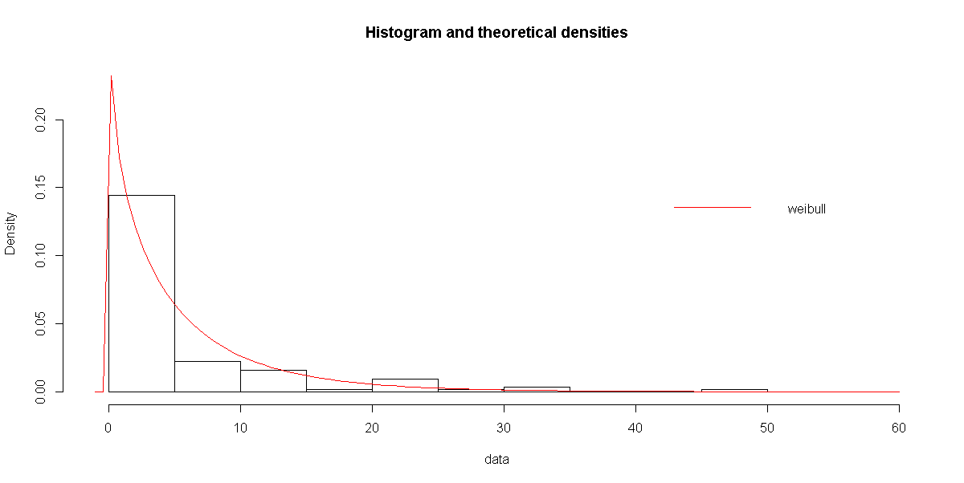
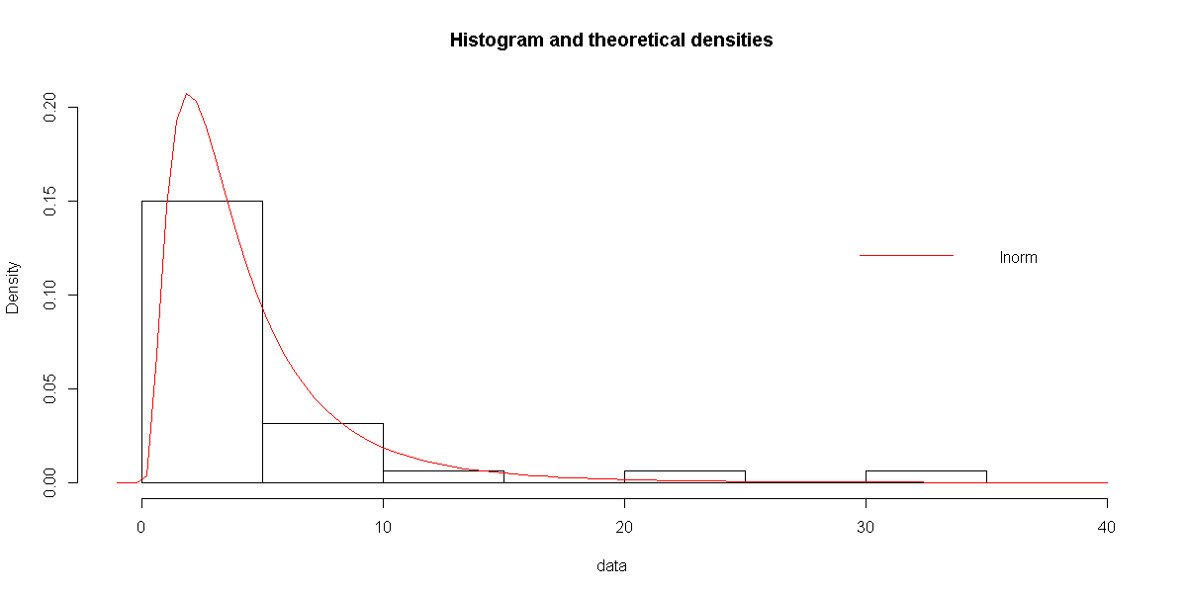
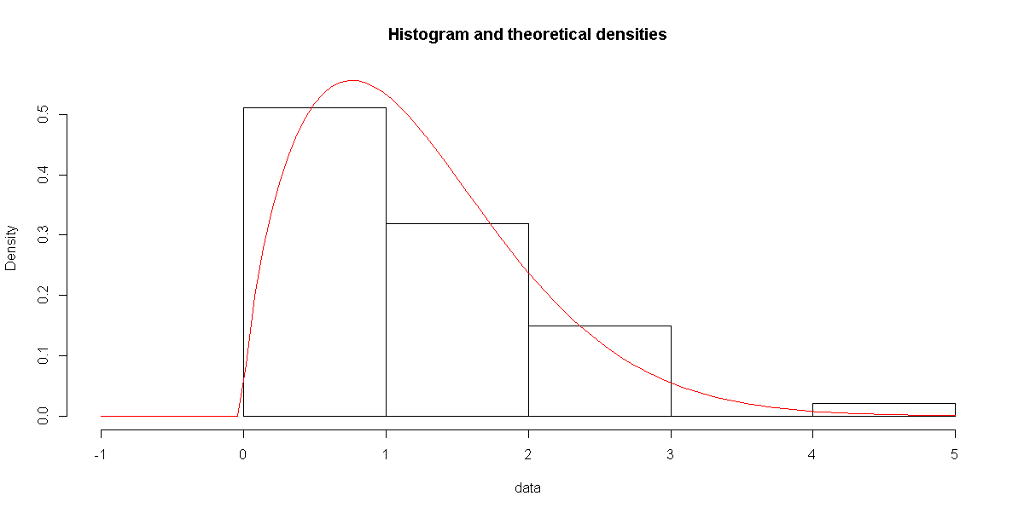
FFIE GRUPO 7
VOLVER
ETAPA OBRA
ETAPA PREVIA
LIQUIDACIÓN
DURACIÓN
PAGOS
DURACIÓN
PAGOS
DURACIÓN
PAGOS

Slide 3
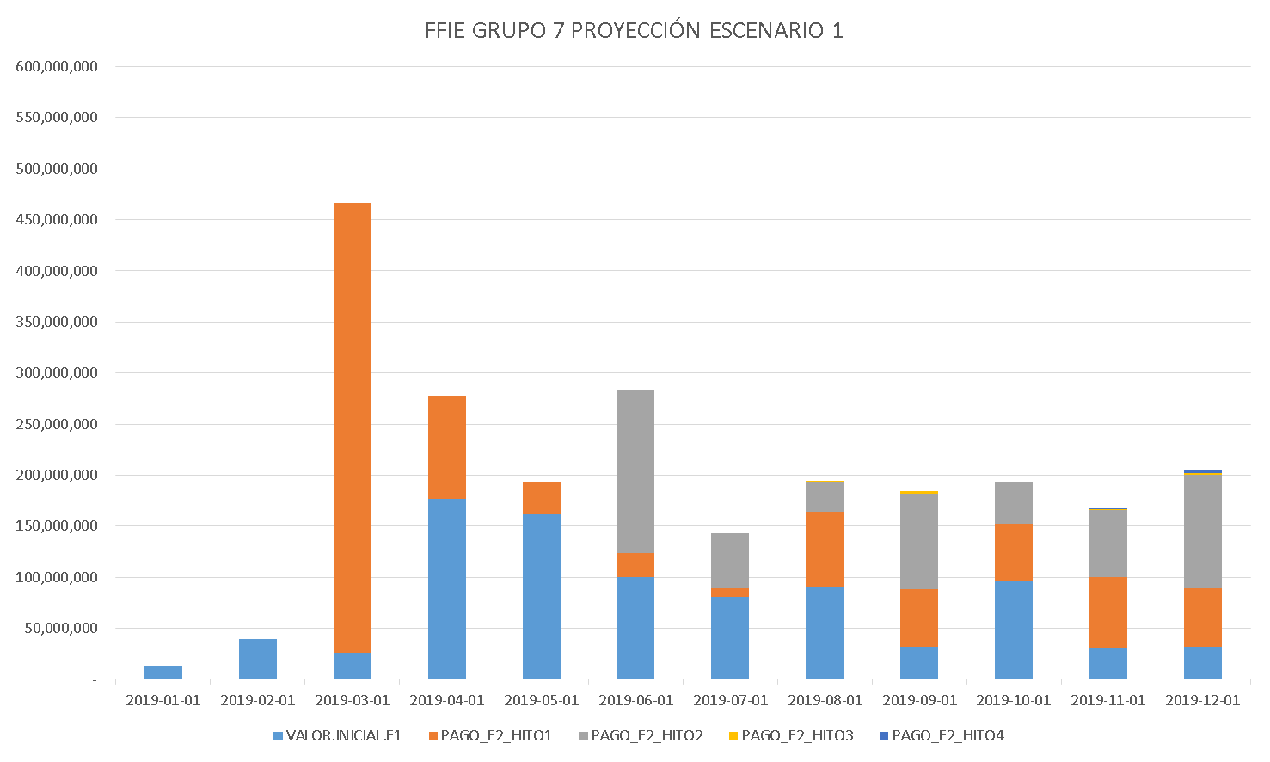
FFIE GRUPO 7 – ESCENARIO 1
VOLVER

Slide 4
FFIE GRUPO 7 – ESCENARIO 1
VOLVER
FECHA | PAGO FASE 1 | PAGO HITO1 | PAGO HITO2 | PAGO HITO3 | PAGO HITO4
ene-19 | 13,105,734
feb-19 | 39,691,875
mar-19 | 26,419,974 | 440,227,603
abr-19 | 176,940,142 | 100,817,841
may-19 | 161,245,003 | 32,080,408
jun-19 | 100,412,416 | 23,112,412 | 160,340,221
jul-19 | 80,851,657 | 8,029,540 | 54,078,546
ago-19 | 90,607,045 | 73,411,688 | 29,703,161 | 888,363
sep-19 | 32,269,326 | 55,864,217 | 94,155,828 | 2,337,796
oct-19 | 96,569,065 | 55,777,244 | 40,081,343 | 522,998
nov-19 | 30,889,040 | 68,993,500 | 65,796,096 | 1,007,549 | 789,006
dic-19 | 31,992,375 | 57,631,283 | 110,595,086 | 1,710,956 | 3,359,850
TOTAL | 880,993,652 | 915,945,734 | 554,750,281 | 6,467,662 | 4,148,857

Slide 5
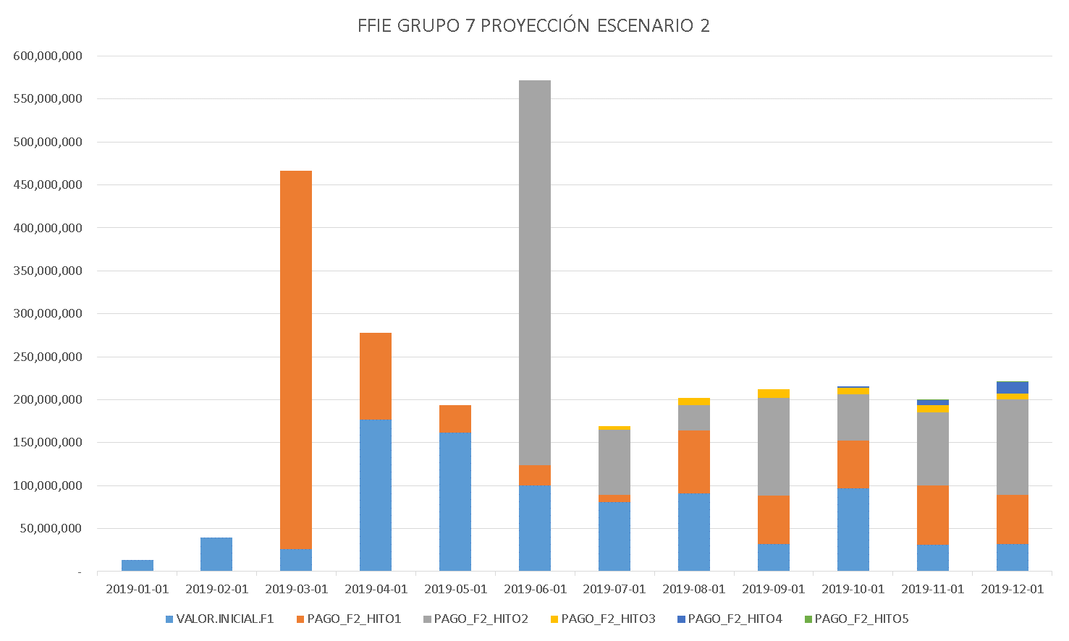
FFIE GRUPO 7 – 5 MESES DE ESPERA PARA REINICIO
VOLVER

Slide 6
FFIE GRUPO 7 – ESCENARIO 2
VOLVER
FECHA | PAGO FASE 1 | PAGO HITO1 | PAGO HITO2 | PAGO HITO3 | PAGO HITO4 | PAGO HITO5
ene-19 | 13,105,734
feb-19 | 39,691,875
mar-19 | 26,419,974 | 440,227,603
abr-19 | 176,940,142 | 100,817,841
may-19 | 161,245,003 | 32,080,408
jun-19 | 100,412,416 | 23,112,412 | 447,823,570
jul-19 | 80,851,657 | 8,029,540 | 76,256,820 | 3,962,699
ago-19 | 90,607,045 | 73,411,688 | 29,703,161 | 8,071,951
sep-19 | 32,269,326 | 55,864,217 | 114,226,570 | 9,764,388
oct-19 | 96,569,065 | 55,777,244 | 53,879,978 | 7,394,570 | 1,981,350
nov-19 | 30,889,040 | 68,993,500 | 85,239,628 | 8,309,733 | 5,742,381 | 851,980
dic-19 | 31,992,375 | 57,631,283 | 110,595,086 | 6,942,136 | 13,101,075 | 1,135,974
TOTAL | 880,993,652 | 915,945,734 | 917,724,813 | 44,445,477 | 20,824,806 | 1,987,954

Slide 7
VOLVER
GRUPO 2
FFIE
GRUPO 7 (1706)

Slide 8
FFIE – GRUPO 2 – FASE 2 - OBRA
VOLVER
COLEGIO | FECHA FIN PROGRAMADA | SALDO FASE 2 | 20 % GARANTÍA | PAGO AL FINAL
IE Roberto García Peña Sede A | 29-mar-19 | $ 69,749,389 | $ 56,003,818 | $ 13,745,571
IE Roberto García Peña Sede C | 25-ene-19 | $ 38,577,410 | $ 37,009,964 | $ 1,567,446
IE Empresarial Y Agroindustrial Los Andes | 5-feb-19 | $ 50,563,879 | $ 33,377,766 | $ 17,186,113
IE Vicente Azuero Sede C | 15-mar-19 | $ 36,061,686 | $ 22,501,985 | $ 13,559,701
IE Santa María Goretti Sede C | 28-ene-19 | $ 75,354,095 | $ 35,625,591 | $ 39,728,504
IE Normal Superior Sede Ppal | 19-feb-19 | $ 207,659,962 | $ 72,147,410 | $ 135,512,552
IE Nueva Generación Sede Urbana Mixta | 10-feb-19 | $ 69,053,436 | $ 24,820,960 | $ 44,232,476
IE Juan Cristóbal Martínez Sede C | 24-feb-19 | $ 64,848,173 | $ 58,753,762 | $ 6,094,411
IE Colegio Nuevo Puerto Madero | 21-feb-19 | $ 206,729,819 | $ 72,897,754 | $ 133,832,065
IE Luis Carlos Galán S. Villas SJ | 28-mar-19 | $ 55,622,612 | $ 36,369,002 | $ 19,253,610
IE Ángulo Sede A | 28-feb-19 | $ 37,647,404 | $ 23,557,254 | $ 14,090,150
IE Luis Carlos Galán S.- Mirador A. | 21-feb-19 | $ 250,132,471 | $ 79,482,269 | $ 170,650,202
TOTAL |  | $ 1,162,000,336 | $ 552,547,536 | $ 609,452,800

Slide 9
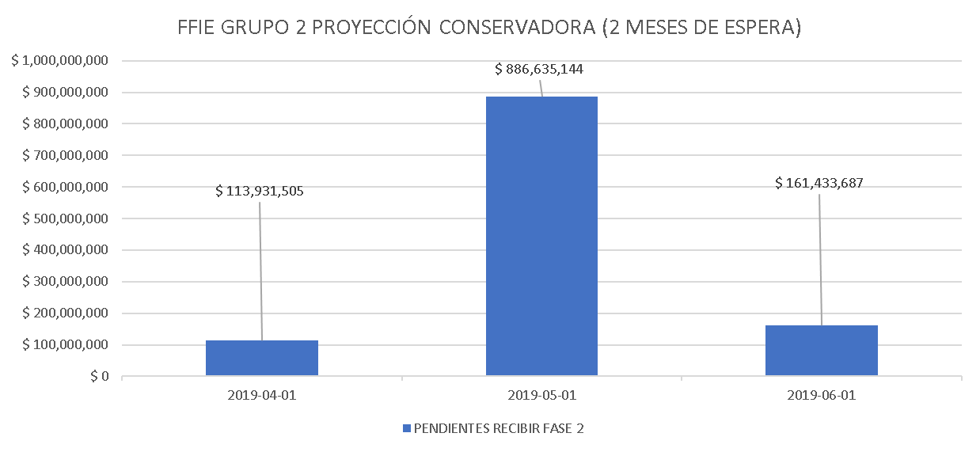
FFIE – GRUPO 2 – FASE 2 - OBRA
VOLVER

